Slide 1
Quaternions and More
Stavve Dubin

Slide 2
Objectives
Motivation
Rotations in 2D
blueprint for 3D
Rotations in 3D
what’s missing?
Quaternions
neat solution (what are they, connection to rotations, how they are easier to compute with)

Slide 3
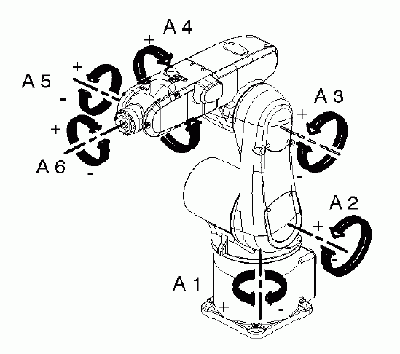

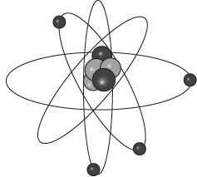
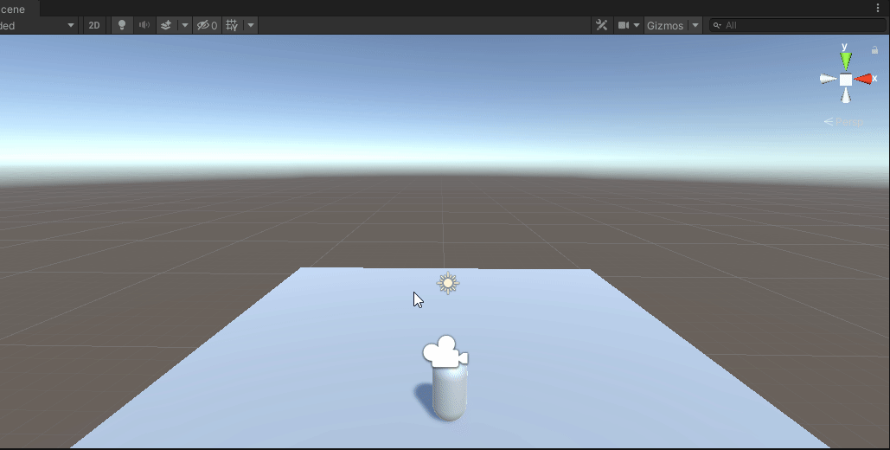
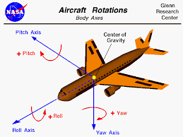
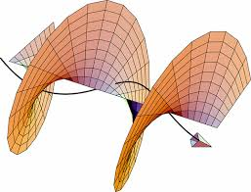
What are rotations?
Computer Games – camera motion
Plaines and Rockets are rotating in 3D
Physics/Waves
Earth/Planets/Galaxies
Molecules/Atoms/Particles

Slide 4
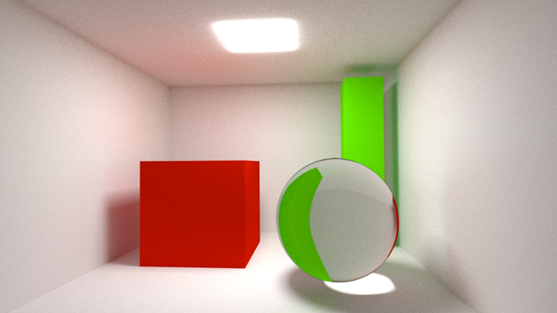
Examples : How do we create a picture like this?

Slide 5
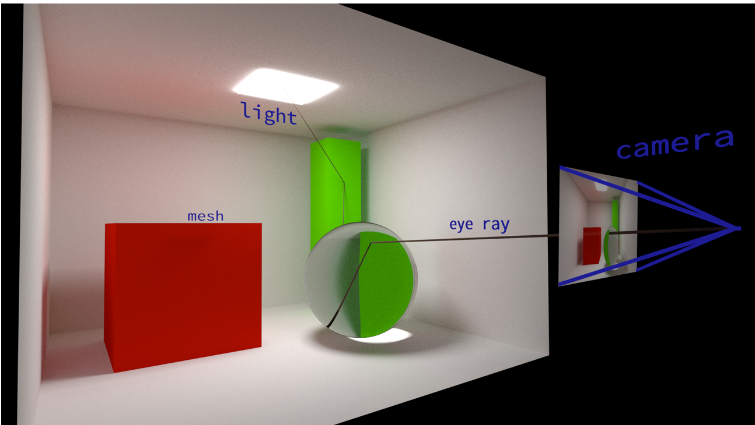
Examples : Ray Tracing – Camera Motion

Slide 6
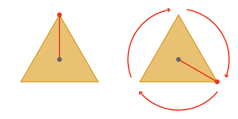
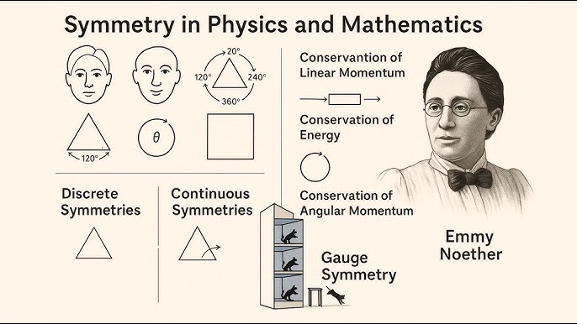
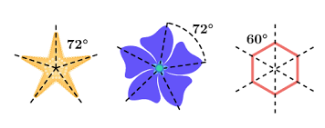
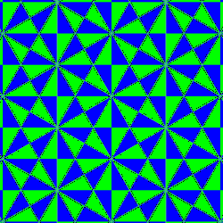
Why rotations are important? Symmetries
y = F(x) - any physical law or function…..
|y| = |x| - no energy loss/expansion/contraction
F - rotations

Slide 7
Rotations in 2D

Slide 8
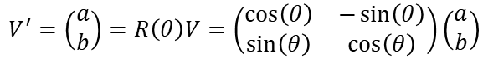
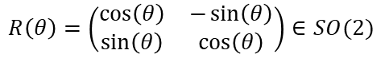

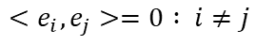
Rotation in 2D - $SO(2)$
Orthonormal basis vectors
Rotation Matrix
Rotation
$${e_{i}^{2}={e_{i}e}_{i}=1}_{}$$
$${<e_{i},e_{j}>=0 : i≠j}_{}$$
$$R\left(θ\right)=\left(\begin{matrix}\cos\left(θ\right) & −\sin\left(θ\right) \\ \sin\left(θ\right) & \cos\left(θ\right)\end{matrix}\right)∈SO(2)$$
$$V^{′}=\left(\begin{matrix}a \\ b\end{matrix}\right)=R\left(θ\right)V=\left(\begin{matrix}\cos\left(θ\right) & −\sin\left(θ\right) \\ \sin\left(θ\right) & \cos\left(θ\right)\end{matrix}\right)\left(\begin{matrix}a \\ b\end{matrix}\right)$$

Slide 9
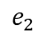
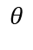
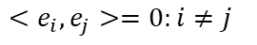
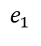


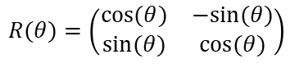
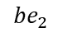
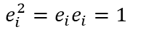
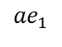
Rotation in 2D
$${V′= a_{}^{′}e+b′e}_{2}$$
Basis vectors
Rotation Matrix
Rotation
$${V= {ae}_{1}+be}_{2}$$
$${e_{i}^{2}={e_{i}e}_{i}=1}_{}$$
$${be}_{2}$$
$${<e_{i},e_{j}>=0:i≠j}_{}$$
$$θ$$
$$e_{2}$$
$$R(θ)=\left(\begin{matrix}cos⁡(θ) & −sin⁡(θ) \\ sin⁡(θ) & cos⁡(θ)\end{matrix}\right)$$
$$e_{1}$$
$${ae}_{1}$$
$$V^{′}=\left[\begin{matrix}a′ \\ b′\end{matrix}\right]=R\left(θ\right)V=\left(\begin{matrix}cos⁡(θ) & −sin⁡(θ) \\ sin⁡(θ) & cos⁡(θ)\end{matrix}\right)\left[\begin{matrix}a \\ b\end{matrix}\right]=\left[\begin{matrix}a \cos\left(θ\right)−b sin\left(θ\right) \\ a sin\left(θ\right)\text{+} b\cos\left(θ\right)\end{matrix}\right]$$

Slide 10
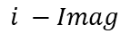
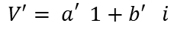
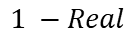
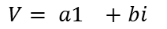
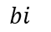
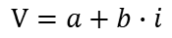
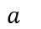
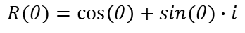
Complex Numbers
$${V′= a_{}^{′}1+b′}_{}i$$
Rotations in 2D - Euler formula:
Rotation:
$${V= {a1}_{}+bi}_{}$$
$${bi}_{}$$
$$R(θ)=\cos\left(θ\right)+sin(θ)∙i$$
$$i −Imag$$
$$θ$$
$$1 −Real$$
$$a_{}$$
$$V=a+b∙i$$
$V^{′}=R\left(θ\right)V=(a$ $\cos\left(θ\right)−b sin\left(θ\right))+(a sin\left(θ\right)\text{+}\text{b} \cos\left(θ\right))∙i$

Slide 11
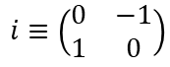
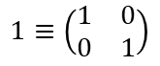
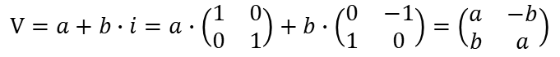
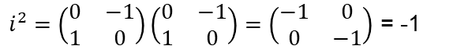
Representation By Matrices
Define Matrices:
Then:
Every complex vector:
$$1≡\left(\begin{matrix}1 & 0 \\ 0 & 1\end{matrix}\right)$$
$$i≡\left(\begin{matrix}0 & −1 \\ 1 & 0\end{matrix}\right)$$
$i^{2}=\left(\begin{matrix}0 & −1 \\ 1 & 0\end{matrix}\right)\left(\begin{matrix}0 & −1 \\ 1 & 0\end{matrix}\right)=\left(\begin{matrix}−1 & 0 \\ 0 & −1\end{matrix}\right)$ = -1
$$V=a+b∙i=a∙\left(\begin{matrix}1 & 0 \\ 0 & 1\end{matrix}\right)+b∙\left(\begin{matrix}0 & −1 \\ 1 & 0\end{matrix}\right)=\left(\begin{matrix}a & −b \\ b & a\end{matrix}\right)$$

Slide 12
Disadvantages of Algebra of Vectors in 2D
 | Addition | Multiplication
Scalar & Scalar | Defined | Defined
Scalar & Vector | Not Defined | Defined
Vector & Vector | Defined | Not Defined

Slide 13
Advantages of Algebra of Complex Numbers
 | Addition | Multiplication
Scalar & Scalar | Defined | Defined
Scalar & Vector | Defined | Defined
Vector & Vector | Defined | Defined
Group under addition and multiplication*:
a • b = c, (a • b) • c = a • (b • c) , e • a = a • e = a, a • a⁻¹ = e

Slide 14
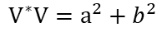
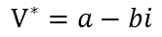
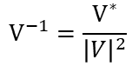
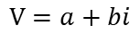
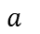
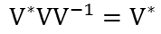
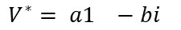
Inverse - Dual
$${V′= a_{}^{′}1+b′}_{}i$$
We want to find V⁻¹ : V V⁻¹ = 1
Conjugate:
Multiply by V* from the left:
$${V= {a1}_{}+bi}_{}$$
$${bi}_{}$$
$$i$$
$$V=a+bi$$
$$V^{∗}=a−bi$$
$$1 −Real$$
$$a_{}$$
$${V^{∗}VV}^{−1}=V^{∗}$$
$$V^{∗}V=a^{2}+b^{2}$$
$${V^{∗}= {a1}_{}−bi}_{}$$
$$V^{−1}=\frac{V^{∗}}{{\left|V\right|}^{2}}$$

Slide 15
Rotations in 3D

Slide 16
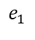
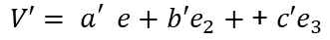

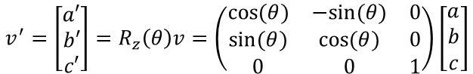
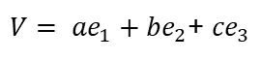
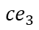
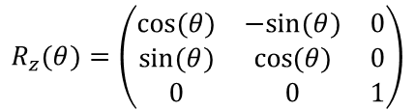
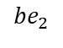
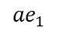
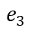

Rotation in 3D - $SO\left(3\right)$
$${V′= a_{}^{′}e+b′e}_{2}+\text{+ }{c′e}_{3}$$
Basis vectors
Rotation Matrix around e₃ (z):
Rotation
$${ce}_{3}$$
$${e_{i}^{2}={e_{i}e}_{i}=1}_{}$$
${V= {ae}_{1}+be}_{2}$+ ${ce}_{3}$
$${{<e}_{i},e_{j}>=0:i≠j}_{}$$
$$e_{3}$$
$$e_{1}$$
$$R_{z}(θ)=\left(\begin{matrix}cos⁡(θ) & −sin⁡(θ) & 0 \\ sin⁡(θ) & cos⁡(θ) & 0 \\ 0 & 0 & 1\end{matrix}\right)$$
$${ae}_{1}$$
$$γ$$
$$e_{2}$$
$${be}_{2}$$
$$v^{′}=\left[\begin{matrix}a′ \\ b′ \\ c′\end{matrix}\right]=R_{z}\left(θ\right)v=\left(\begin{matrix}cos⁡(θ) & −sin⁡(θ) & 0 \\ sin⁡(θ) & cos⁡(θ) & 0 \\ 0 & 0 & 1\end{matrix}\right)\left[\begin{matrix}a \\ b \\ c\end{matrix}\right]$$
Notes:
Credit: stack exchange

Slide 17




Problems with matrices in 3D – Euler Angles Ambiguity
Angle vector defines ($α,β,γ$) : Axis rotation matrices:
The full rotation matrix
No convention have been established with Euler angles
$$R_{x}(α)=\left(\begin{matrix}1 & 0 & 0 \\ 0 & cos⁡(α) & −sin⁡(α) \\ 0 & sin⁡(α) & cos⁡(α)\end{matrix}\right)$$
$$R_{y}(β)=\left(\begin{matrix}cos⁡(β) & 0 & sin⁡(β) \\ 0 & 1 & 0 \\ −sin⁡(β) & 0 & cos⁡(β)\end{matrix}\right)$$
$$R_{z}(γ)=\left(\begin{matrix}cos⁡(γ) & −sin⁡(γ) & 0 \\ sin⁡(γ) & cos⁡(γ) & 0 \\ 0 & 0 & 1\end{matrix}\right)$$
${R\left(α,β,γ\right)= R}_{x}(α)$ $R_{y}\left(β\right)R_{z}\left(θ\right) ≠R_{z}\left(θ\right)$ $R_{y}\left(β\right)$ $R_{x}\left(γ\right)….$
Notes:
Our main problem is – how do we know which rotation matrix to use?

Slide 18



The problem with Euler angles - Gimbal Lock
Notes:
What is the problem with Euler angles? They can fail due to a gimbal lock. Gimbal lock happens when two axes align, causing the system to lose a degree of freedom (the rotation matrix is not invertible).

Slide 19

Gimbal Lock
Given vector up :
Notes:
We can see that with 2 different sets of angles we get the same rotation matrix. It is a problem when the rotation matrix is not unique.

Slide 20

Gimbal lock example
Credit to : Quaternions Freya Holmer
Notes:
We can see that rotations do not commute. The order in which we apply the rotation matters.

Slide 21




Rotations are Non-commutative
$R=R_{y}\left(θ\right)$ $R_{z}\left(φ\right)$
Credit to : Quaternions Freya Holmer
$$R={R_{z}\left(φ\right)R}_{y}\left(θ\right)$$
Notes:
We can see that rotations do not commute. The order in which we apply the rotation matters.

Slide 22








Interpolation Problem?
$$V_{2}$$
$${ce}_{3}$$
$$V_{3}=??$$
Given 2 directional vectors:
How to find $V_{3}$in the “middle”?
Bad idea – linear interpolation:
Why?
$V_{1}=R\left(α_{1},β_{1}, γ_{1}\right)∙$1
$$V_{1}$$
$V_{2}=R\left(α_{2},β_{2}, γ_{2}\right)∙$1
$$e_{3}$$
$$e_{1}$$
$${ae}_{1}$$
$${V_{3}=t∙V}_{1}+(1−t)∙V_{2}$$
$$e_{2}$$
$${be}_{2}$$
$\left\|V_{1}\right\|$= $\left\|V_{2}\right\|=1≠\left\|V_{3}\right\|$

Slide 23
Algebra of Vectors in 3D
 | Addition | Multiplication
Scalar & Scalar | Defined | Defined
Scalar & Vector | Not Defined | Defined
Vector & Vector | Defined | Not Defined
Euler Angles
Gimbal Lock
Interpolation

Slide 24
Quaternions and Motivation

Slide 25

Notes:
Picture from Wikipedia
Why were quaternions so important that the man that invented them wanted to be remembered by them?

Slide 26
Problems in 3D Matrix Representation
 | Addition | Multiplication
Scalar & Scalar | Defined | Defined
Scalar & Vector | Not Defined | Defined
Vector & Vector | Defined | Not Defined
Euler Angles – the sequence ???
Gimbal Lock
Interpolation

Slide 27








Similarity of Complex Numbers and Quaternions
Complex Numbers
Conjugate
$$z=x−iy$$
Inverse
Quaternions
Conjugate
$q= q_{0}−iq_{1}−jq_{2}−kq_{3}$
Inverse
$$z=x+iy ∈ℂ$$
$$i^{2}=−1$$
$$q= q_{0}+iq_{1}+jq_{2}+kq_{3}∈ℍ$$
$$i^{2}=−1$$
$$j^{2}=−1$$
$$k^{2}=−1$$
$ij=k, jk=i, ki$=j
$$z= e^{iφ}=\cos\left(φ\right)+i∙sin(φ)$$
$$z=\cos\left(φ\right)+\overset{⃑}{n}∙sin\left(φ\right)$$
Notes:
“Think about quaternions as 4 – dimensional extension of the complex numbers”
On the board: Real: a+ 0i, Complex: a + bi + 0j + ok, Quaternion: a+ bi +cj +dk.
NOT SURE IF TO INCLUDE THE CONJUGATE AND INVERSE

Slide 28
A Foundation of Abstract Algebra
In the realm of mathematics, a group is a fundamental algebraic structure consisting of a set of elements equipped with a binary operation that satisfies four key axioms:
Closure: For any two elements 'a' and 'b' in the set, the result of the operation, 'a • b', is also in the set.
Associativity: For any elements 'a', 'b', and 'c' in the set, the equation (a • b) • c = a • (b • c) holds true.
Identity Element: There exists a unique element 'e' in the set such that for any element 'a', the equation e • a = a • e = a is satisfied.
Inverse Element: For each element 'a' in the set, there exists an element 'b' in the set, known as the inverse of 'a', such that a • b = b • a = e.

Slide 29

Abstract Algebra - Groups
Closure: $a,b∈G⟹a∘b∈G$.
Associativity: $a,b,c∈G⟹a∘\left(b∘c\right)=\left(a∘b\right)∘c$.
Identity Element: $∃e∈G:a∘e=e∘a=a$. Further, $e$ is unique.
Inverse Element: $∀a∈G, ∃a^{−1}∈G:a∘a^{−1}=a^{−1}∘a=e$.

Slide 30






Quaternion
Basis vectors
What is this object?
$${e_{1}^{2}=e_{2}^{2}=e_{3}^{2}=−1}_{}$$
${e_{i}e_{j}=−e_{i}e_{j}:i≠j}_{}$- anti commute
$1≡\left(\begin{matrix}1 & 0 \\ 0 & 1\end{matrix}\right)$,
$$e_{1}≡\left(\begin{matrix}0 & 1 \\ 1 & 0\end{matrix}\right)$$
$$e_{2}≡\left(\begin{matrix}0 & −i \\ i & 0\end{matrix}\right)$$
$$e_{3}≡\left(\begin{matrix}1 & 0 \\ 0 & −1\end{matrix}\right)$$

Slide 31

Geometrical Meaning
Complex Numbers
Quartertones

Slide 32


How do we get the axis and angle of rotation?
Euler matrices computation and final rotation matrix:
$$\left(\begin{matrix}0.3745 & 0.9507 & 0.7320 \\ 0.5987 & 0.1560 & 0.1560 \\ 0.0581 & 0.8662 & 0.6011\end{matrix}\right)\left(\begin{matrix}0.7081 & 0.0206 & 09699 \\ 0.8324 & 0.2123 & 0.1818 \\ 0.1834 & 0.3042 & 0.5248\end{matrix}\right)\left(\begin{matrix}0.4319 & 0.2912 & 0.6119 \\ 0.1395 & 02921 & 0.3664 \\ 0.4561 & 0.7852 & 0.1997\end{matrix}\right)=\left(\begin{matrix}0.9944 & 1.1957 & 1.0708 \\ 0.5796 & 0.7392 & 0.5283 \\ 0.6696 & 0.7772 & 0.7743\end{matrix}\right)$$
Compute Eigenvalues and Eigenvectors:
$\det\left(A−λI\right)=0$ ,
$\left(\begin{matrix}0.9944−λ & 1.1957 & 1.0708 \\ 0.5796 & 0.7392−λ & 0.5283 \\ 0.6696 & 0.7772 & 0.7743−λ\end{matrix}\right)$=0
($0.9944−λ$) * [ ($0.7392−λ$)*($0.7743−λ$) - (0.5283)*(0.7772) ] - (1.1957) * [ (0.5796)*($0.7743−λ$) - (0.5283)*(0.6696) ] + (1.0708) * [ (0.5796)*(0.7772) - ($0.7392−λ$)*(0.6696) ] = 0
-λ³ + aλ² + bλ + c = 0
$λ_{1}=\text{2}\text{.}\text{4008 }\text{,}λ_{2}=\text{−}\text{0}\text{.}\text{0016}$, $λ_{3}=\text{0.1087}$

Slide 33

Introducing quaternions
$\text{ℍ} ≅ ℝ^{4}$ = $ℝ{×ℝ}^{3}$ = Re($\text{ℍ}$)$×$Im($\text{ℍ}$)
$∀q∈ ℝ , q=q_{0 }+$ ${iq}_{1 }+$ $jq_{2 }+$ $kq_{3 }$
If the real part ($q_{0 }$) is 0, it’s called a pure quaternion
Real part
Vector part
Notes:
Write on the board: for any a,b in Im(H)=R^3: ab=a(cross product)b -<a,b>
Remove the norm

Slide 34


Numerical Example ????
$$q_{1 }=\cos\left(\frac{π}{2}\right)+\sin\left(\frac{π}{2}\right)∙\left(\begin{matrix}1 \\ 0 \\ 0\end{matrix}\right)=0+1i$$
$q_{2 }=\cos\left(\frac{π}{4}\right)+\sin\left(\frac{π}{4}\right)∙\left(\begin{matrix}0 \\ 1 \\ 0\end{matrix}\right)$ =$\frac{1}{√2}$ + $\frac{1}{√2}j$
$q_{1}q_{2}=\left(0+1i\right)\left(\frac{1}{\sqrt{2}}\text{ + }\frac{1}{\sqrt{2}}j\right)=$ $\frac{1}{√2}i+\frac{1}{√2}k$ = $\frac{1}{√2}∙\left(\begin{matrix}1 \\ 0 \\ 1\end{matrix}\right)$
$q_{1}q_{2}$ = $\cos{(φ)}+\sin\left(φ\right)\overset{→}{n}$
$φ=\frac{π}{2}$
$$\overset{→}{n}$$
Notes:
Cos(phi) = 0 , sin(phi) =1

Slide 35

Why Quaternions?
Sp(1) $∶=\{q∈\text{ℍ}∶\left|q\right|=1\}$ unit Quaternions
$q_{1}q_{2}=\left(0+1i\right)\left(\frac{1}{\sqrt{2}}\text{ + }\frac{1}{\sqrt{2}}j\right)=$ $\frac{1}{√2}i+\frac{1}{√2}k$ = $\frac{1}{√2}∙\left(\begin{matrix}\begin{aligned}0 \\ 1\end{aligned} \\ 0 \\ 1\end{matrix}\right)$
Notes:
Cos(phi) = 0 , sin(phi) =1

Slide 36



Properties of quaternions
$$i^{2}=j^{2}=k^{2}=−1$$
$\text{ℍ} \text{= }ℝ^{4}$ = $ℝ{∙ℝ}^{3}$ = Re($\text{ℍ}$)$∙$Im($\text{ℍ}$)
$∀∈ ℝ , q=q_{0 }+$ ${iq}_{1 }+$ $jq_{2 }+$ $kq_{3 }$
$$ij=k,jk=i,ki=j$$
${\left|q\right|}^{2}=qq^{∗}={(q}_{0 }+$ ${iq}_{1 }+$ $jq_{2 }+$ $kq_{3 }$)($q_{0 }−$ ${iq}_{1 }−$ $jq_{2 }−$ $kq_{3 }$) $=$
$={(q}_{0 }q_{0 }+$ ${iq}_{1 }+$ $jq_{2 }+$ $kq_{3 }$)($q_{0 }−$ ${iq}_{1 }−$ $jq_{2 }−$ $kq_{3 }$) $=$
$=q_{0 }q_{0 }−{iq}_{1 }{iq}_{1 }+{iq}_{1 }(−jq_{2 })+$ $jq_{2 }(− {iq}_{1 })+$ $….=$
$=q_{0}^{2}+q_{1}^{2}+q_{2}^{2}+$ $q_{3}^{2}$
Notes:
Write on the board: for any a,b in Im(H)=R^3: ab=a(cross product)b -<a,b>
Remove the norm

Slide 37















Meaning of normalized quaternion – oriented pointing vector
The normalized representation:
$$\vec{n_{3}}=\left(\begin{matrix}a \\ b \\ c\end{matrix}\right){,φ}_{3}$$
$$n_{3}$$
$q=q_{0 }+$ ${iq}_{1 }+$ $jq_{2 }+$ $kq_{3 }=cos\left(φ\right)+\vec{n} sin\left(φ\right)$
$$q_{0 }=cos\left(φ\right)$$
$$φ_{3}$$
$$e_{3}$$
$q_{1 } =a$ $\sin\left(φ\right)$
$q_{2 } =b$ $\sin\left(φ\right)$
$$\vec{n_{1}}=\left(\begin{matrix}1 \\ 0 \\ 0\end{matrix}\right){,φ}_{1}=\frac{π}{2}$$
$q_{3 } =c$ $\sin\left(φ\right)$
$\vec{n}=$ ${ia}_{ }+$ $jb+$ $kc$
$$e_{1}$$
$$n_{1}$$
$\left\|\vec{n}\right\|=1 ⇒$ $\left\|q\right\|=1$
$$e_{2}$$
$\vec{n_{2}}=\left(\begin{matrix}0 \\ 1 \\ 0\end{matrix}\right)$ ,$φ_{2}=\frac{π}{4}$
Notes:
We call n1 rotation R1, and n2 rotation R2
Guys let me just do the matrix multiplication, find the eigenvalues, eigenvectors and the eigenspace. So a short 20 minutes and I will be back.
Or, we can use quaternions, around 5-6 lines. Let me show you how.

Slide 38
Rotation of Quaternions
Reflections

Slide 39







Rotation = 2 Reflections
$$2$$
$$θ$$
$$mirror \#1$$
$$mirror \#1$$
$$θ/2$$
$$θ$$
$$mirror \#2$$
$$1$$
$$1$$

Slide 40







Complex Rotation as Reflections
$${V′= a_{}^{′}1+b′}_{}i$$
Given:
Rotations in 2D - Euler formula:
$$2$$
$${V= {a1}_{}+bi}_{}$$
$$i^{2}=−1$$
$$1i=i$$
$$θ$$
$$i$$
$$2$$
$$θ/2$$
$$R(θ)=\cos\left(θ\right)+i∙sin(θ)$$
$$1$$
$$v=a+i∙b$$
$$1$$
$v^{′}=R\left(θ\right)V=(a$ $\cos\left(θ\right)−b sin\left(θ\right))+i∙(a sin\left(θ\right)\text{+}\text{b} \cos\left(θ\right))$
$v^{′}=R\left(\frac{θ}{2}\right)R\left(\frac{θ}{2}\right)v=R\left(\frac{θ}{2}\right)vR\left(\frac{θ}{2}\right)$= $R\left(α+\frac{θ}{2}\right)vR\left(−α+\frac{θ}{2}\right)=R\left(α+\frac{θ}{2}\right)v{R\left(α−\frac{θ}{2}\right)}^{∗}$

Slide 41



Reflection of quaternions
$$q$$
The normalized representation:
Reflection around plane given by normal k:
Remember that:
$$k$$
$q=q_{0 }+$ ${iq}_{1 }+$ $jq_{2 }+$ $kq_{3 }$
$$j$$
$q^{′}={kqk^{∗}=kq}_{0 }k^{∗}+k$ ${iq}_{1 }k^{∗}+k$ $jq_{2 }k^{∗}+k$ $kq_{3 }k^{∗}$
$$i$$
$ij=k,jk=i,ki=j$, $k^{∗}=−k,k^{2}=−1,k^{∗}k=1$
$$q^{′}={k(qk^{∗})={k(k}^{∗} q}_{0 }+{ik^{∗}q}_{1 }+{ jk^{∗}q}_{2 }+kk^{∗}q_{3 }){=k(−kq}_{0 }{+j q}_{1 }−iq_{2 }+1 q_{3 })$$
${=−kkq}_{0 }{+kj q}_{1 }−ki q_{2 }+k q_{3 }$ ${=q}_{0 }{−iq}_{1 }−j q_{2 }+k q_{3 }$
Notes:
Not sure about the yellow part

Slide 42
Rotation in Arbitrary Plain - Reflections

Slide 43


Reflect Vector along z-axis:
$\overset{⃑}{v}=x\overset{⃑}{e_{x}}$ + $y\overset{⃑}{e_{y}}$ + $z\overset{⃑}{e_{z}}$
$\overset{⃑}{v}=x\overset{⃑}{e_{x}}$ + $y\overset{⃑}{e_{y}}$ - $z\overset{⃑}{e_{z}}$

Slide 44


Slide 45


Slide 46


Slide 47


Slide 48


Slide 49


Slide 50

Euler Connection

Slide 51



Slide 52


Slide 53
Quaternions : Algebra of Vectors
 | Addition | Multiplication
Scalar & Scalar | Defined | Defined
Scalar & Vector | Defined | Defined
Vector & Vector | Defined | Defined

Slide 54

Main proof
$SP(1)≅SO(3)$
Explain both in a sentence.
Explain they are essentially the same.

Slide 55
Advantages of using Quaternions
Time complexity
Stable solutions
Easy
No gimbal lock
Interpolation

